Slide 1
Progress on COVID-19:
South Africa’s Public Health Response
Minister of Health
26th of May 2020

Slide 2
COVID-19 a dangerous virus and risks will rise
COVID-19 is a reality and the danger is worse now than 5 March when we had our first case
The number of cases are rising sharply (23 615) and will continue to rise as will deaths (481)
The risk to the health system will rise from the current 955 people in hospital and 126 in ICU
The country is far from safe from the damaging effects of the virus
Hard lockdown was necessary to flatten the curve

Slide 3
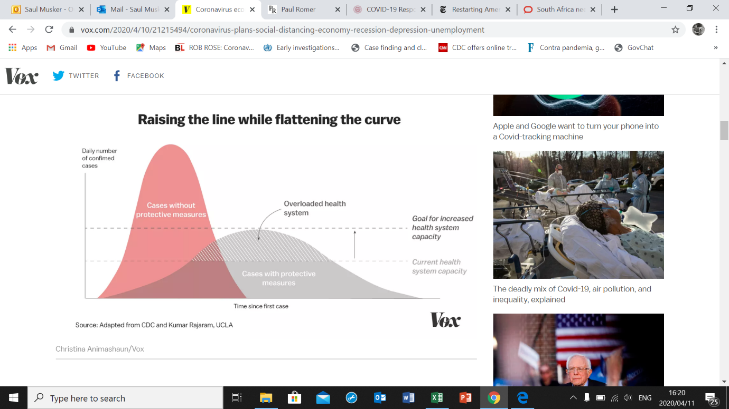
Why flatten the curve early with a lockdown?
Why Flatten the Curve?
Early is better - flattening the curve in advanced epidemics has been difficult to achieve, e.g., UK
To slow community transmission
Provide time to expand healthcare capacity, especially ICU and high-level care
Provide time to better prepare and equip hospitals healthcare workers
To provide time to scale
up testing and prevention
strategies

Slide 4
Emerging from the lockdown: what have we achieved?
The lockdown had to be implemented – it was the right decision and it benefited us:
  Flattened the curve: lowered the number of infections
  Bought us time to prepare the citizens for a new normal and to prepare the health system to deal with patients
    More than 597 000 tests conducted
    More than 13 million people screened for symptoms by more than 40 000 community health workers
    More than 44 000 contact identified

Slide 5
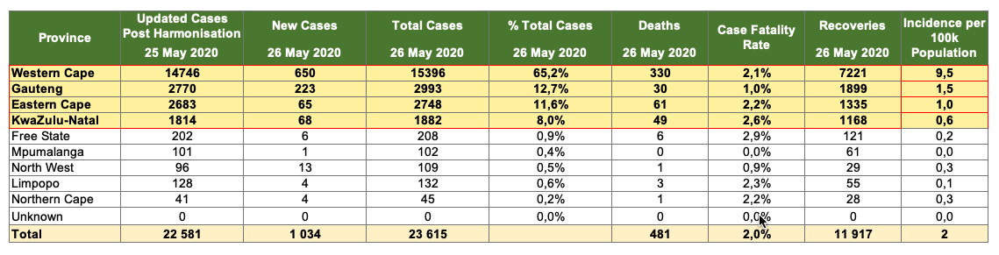
COVID 19: South Africa Epidemiology and Surveillance
Through and including cases and deaths through 25th of May
In South Africa, the total cumulative cases reported is 23 615
The national case fatality rate, based on deaths from is 2.0%, with the total number of deaths at 481
The number of recoveries stands at 11 917

Slide 6
Total # of New Cases since 1st Reported Case
COVID-19 National: Cumulative Cases since 1st reported
Through and including cases and deaths through 25th of May
Total # of Cumulative Cases since 1st Reported Case National
1st reported
case
21 day lockdown
Community
Screening
Level 4
Lockdown
1st reported death
14 day extension

Slide 7
Total # of New Cases since 1st Reported Case
COVID-19 National: Weekly Cumulative Cases and Rate of Change since 1st reported case Through and including cases and deaths through 25th of May
Average Weekly Total # of Cumulative Cases and Weekly Rate of Change since 1st Reported Case National
1st reported
case
21 day lockdown
Community
Screening
Level 4
Lockdown
1st reported death
14 day extension

Slide 8
Total # of New Cases since 1st Reported Case
COVID-19 Provincial: Cumulative Cases since 1st reported
Through and including cases and deaths through 25th of May
Total # of Cumulative Cases since 1st Reported Case by Province
1st reported
case
21 day lockdown
Community
Screening
Level 4 Lockdown
14 day extension
1st reported death
Notes:
guateng, wc and ec

Slide 9
COVID-19 National: Weekly New Cases and Rate of Change since 1st Reported Case Through and including cases and deaths through 25th of May
Total Number of New Cases per week since the 1st Reported Case as well as the Rate of change week on week
21 day lockdown
Level 4
Lockdown

Slide 10
COVID-19 Provincial: Weekly New Cases and Rate of Change since 1st Reported Case Through and including cases and deaths through 25th of May
Total Number of New Cases per week since the 1st Reported Case by Province

Slide 11
Total # of New Cases since 1st Reported Case
COVID-19 National: Deaths since 1st reported Death
Through and including cases and deaths through 25th of May
Total # of Cumulative Deaths since 1st Reported Case
1st reported
case
21 day lockdown
Community
Screening
Level 4 Lockdown
14 day extension
1st reported death
Notes:
Add data label 1st

Slide 12
COVID-19 National: Number of Weekly New Deaths
Through and including cases and deaths through 24th of May
Total Number of New Deaths per week since the 1st Reported Case (National)

Slide 13
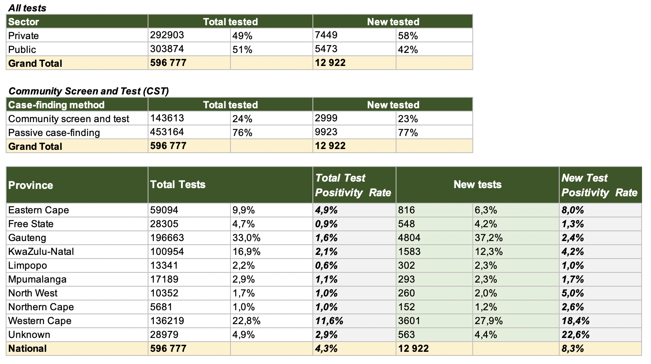
COVID-19 National and Provincial: Laboratory Testing
Through and including testing through through 24th of May
A cumulative total of 596 777 tests have been conducted as at 24th May 2020.
  Of the total number of tests conducted, 12 922 new tests were performed and of those 2 999 tests (23%) were from community screen and testing (CST).
  Of the new tests conducted, 5 473 (42%) have been in the public sector.
Gauteng has performed the highest number of new tests (37.2%) in the last 24 hrs with a positivity rate of 2.4% whereas, the Western Cape has performed 27.9% of new tests in the last 24 hrs with a positivity rate of 18.4%.

Slide 14
COVID-19: Daily number of tests and detection rate
Through and including testing through 24th of May
Notes:
Qqq

Slide 15
COVID-19: Number of tests performed to find Single Positive Case
Through and including testing through 24th of May
Notes:
Qqq

Slide 16
COVID-19: Community Screening
As of 23rd of May, 13 019 227 individuals have been screened nationally and 178 117 individuals have been referred for testing.

Slide 17
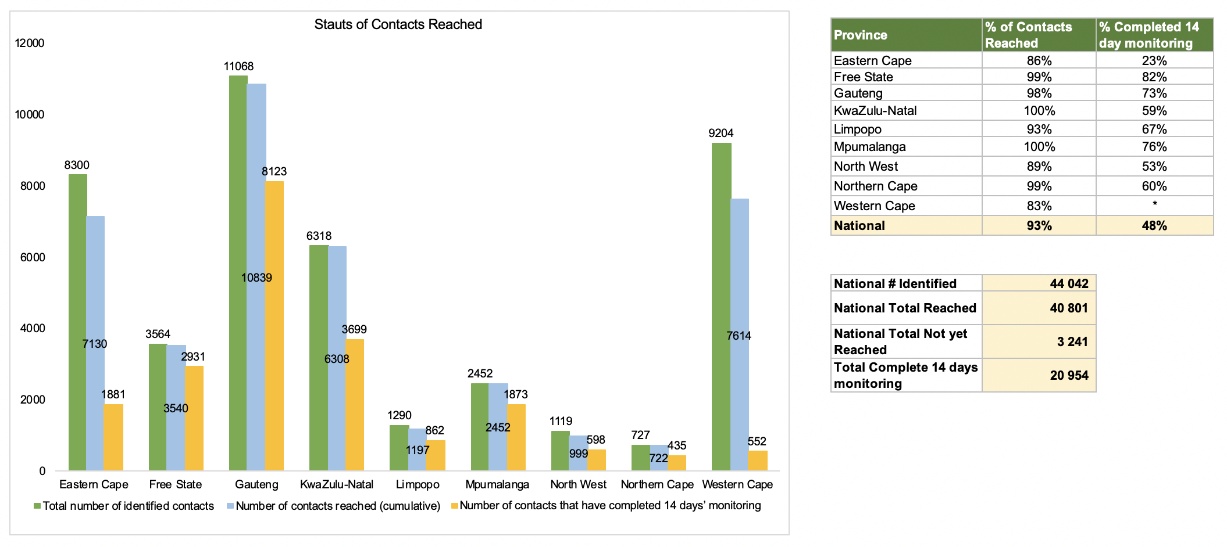
COVID-19: Contact Tracing
As of the 22nd of May, a total of 44 042 contacts have been identified through contact tracing.
To date, 93% (40 801 / 44 042) of contacts have been monitored in South Africa
  Mpumalanga and KwaZulu-Natal have reached 100% of their contacts.

Slide 18
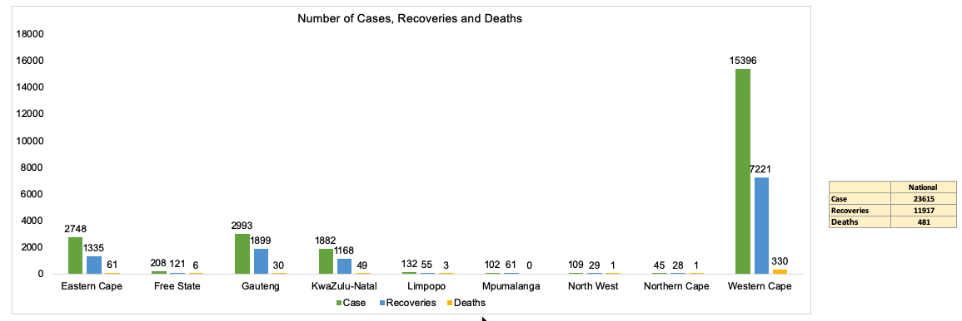
COVID-19: Hospitalisation
Updated as of the 23rd May 2020

Slide 19
COVID-19: Hospitalisation
Updated as of the 24th May 2020

Slide 20
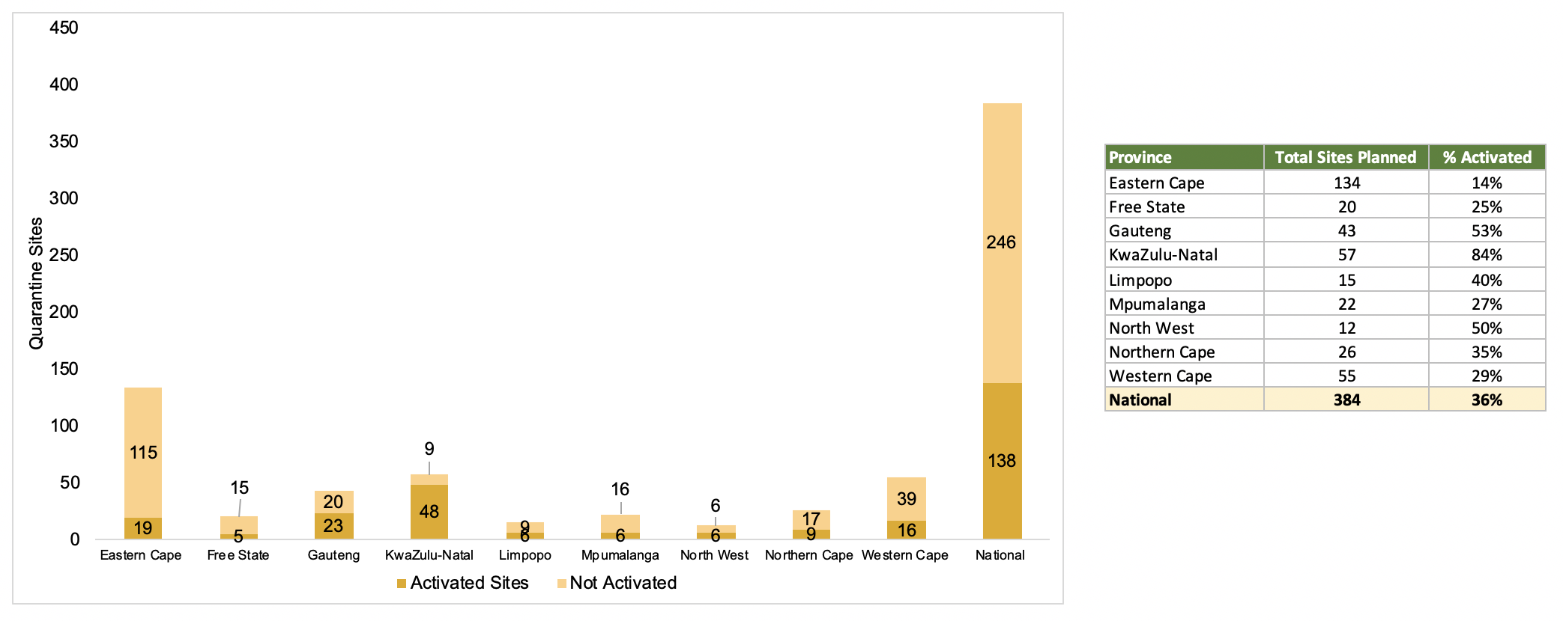
Quarantine Sites
Updated as of the 23rd May 2020
Number of sites that have been activated from of the total planned quarantine sites

Slide 21
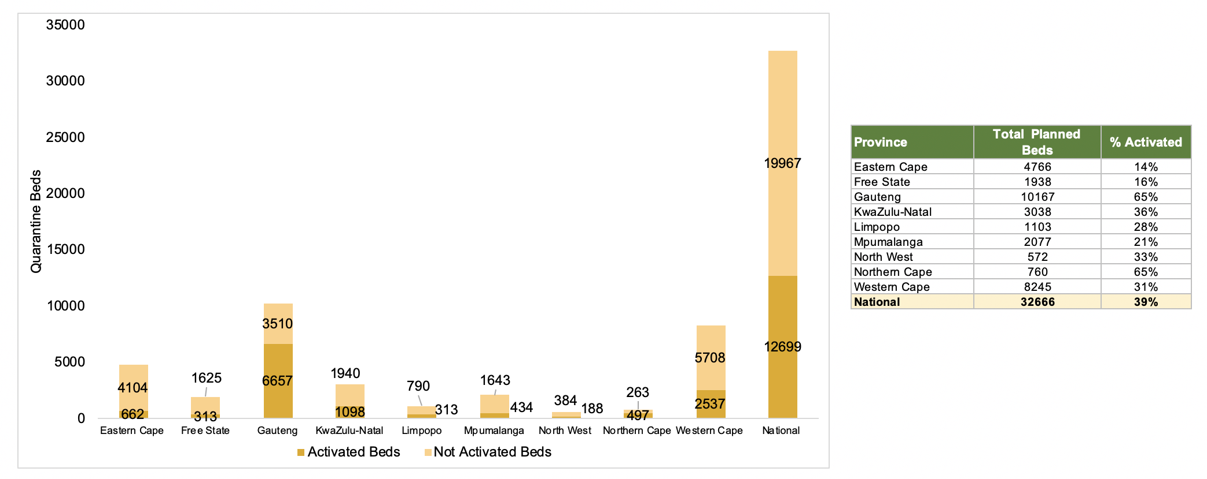
Quarantine Beds
Updated as of the 22nd May 2020
Number of sites that have been activated from of the total planned quarantine sites

Slide 22
Cuban Brigade deployed for Covid-19
 | WC | GP | KZN | EC | FS | MP | LP | NW | NC | NDOH | TOTAL
Family Physician | 18 | 17 | 17 | 12 | 10 | 8 | 8 | 8 | 7 | 0 | 105
Health Technology | 4 | 4 | 4 | 4 | 3 | 3 | 3 | 3 | 2 | 0 | 30
Epidemiology | 3 | 3 | 3 | 2 | 2 | 1 | 1 | 1 | 1 | 1 | 18
Biostatistics | 3 | 4 | 3 | 2 | 2 | 1 | 1 | 1 | 1 | 3 | 21
Public Health Specialist* | 0 | 0 | 0 | 0 | 0 | 0 | 0 | 0 | 0 | 11 | 11
Biotechnologist | 0 | 0 | 0 | 0 | 0 | 0 | 0 | 0 | 0 | 2 | 2
TOTALS | 28 | 28 | 27 | 20 | 17 | 13 | 13 | 13 | 11 | 17 | 187

Slide 23
Trends in estimated active cases
Estimated active cases for each day = cumulative infections in last 14 days minus deaths
Lockdown
easing starts
Lockdown
State of
disaster

Slide 24
Doubling time of cases - to 16 May
Before lockdown
Doubling: 2 days
After lockdown
Doubling: 15 days
Lockdown
easing starts
Doubling: 12

Slide 25
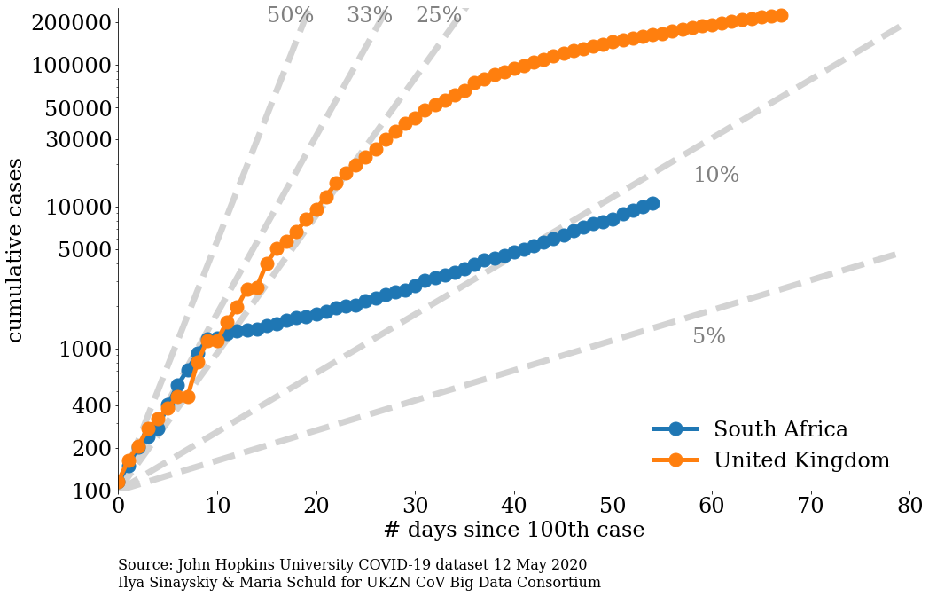
SA’s epidemic trajectory – to 14 May: SA compared to U.K.
Log scale
Source: Tulio de Oliveira & Ilya Sinayskly &
UKZN CoV Big Data Consortium – 14 May 2020;
Notes:
Tulio to send updated figure from day of first case and from 100th case

Slide 26
Lockdown challenges
Need to balance the benefits of the hard lockdown with the challenges that it presents
  Lack of income
  Hunger
  Economic downturn
  Social distress (funerals, religious events, weddings)
Hard lockdown is no longer sustainable in its current form & need to readjust

Slide 27
Move from national lockdown to a differentiated approach
Number of cases per district is variable with some districts have very few cases and other significantly more
There is little value in stringent measures in those districts where there is low or no infection
In those districts where there is high infection rates (active cases) should be the focus of intensive action.
Hence the focus of our interventions and restrictions should be aligned to the burden of infection (active cases)
Implement prevention toolbox with greater sense of urgency and uniformly in society

Slide 28
Determination of the alert levels for districts
Minister of Health to identify the alert levels for each district taking account of the burden of active cases, trends in the active cases and the health system capacity to respond to the disease burden.
The Provincial Command Council must consider these levels and submit provincial plans to contain the spread of the epidemic including health measures, economic activity, restrictions on movement, social services
Minister of Health will present to the NCCC the proposed alert level per district with the provincial plans to contain the infection
The NCCC must confirm an alert level and monitor the provincial plans to contain the infection

Slide 29
Progressing from generalized lockdown to risk-based strategy
Current generalized lockdown eased to level 3, for those districts that do not have hotspots . At level 3 there would be vigilance and close monitoring of areas of infection
High risk areas will be classified as hotspots and these districts will remain at level 4 with intensive implementation of screening testing and restrictions
In two weeks the districts will be reviewed again with a view to classifying districts across the five alert levels. It is anticipated that there will be districts that are at levels 1 to 5.
Continued caution, including self-quarantine as appropriate, for those over 60 years old, or with high risk chronic co-morbidities - a specific communication strategy should be designed for these populations.

Slide 30
District-level alert system with Hotspot implementation
District-level alert systems should be implemented including ongoing monitoring of the number and severity of cases, geo-spatial location of cases, monitoring of health care capacity and utilisation of surge capacity when required
Implementation of Hotspots to identify outbreaks and hotspots early will be critical for minimizing workplace interruptions as multiple outbreaks are expected to increase as the country nears the surge.
Progressively expand capacity, starting with highest risk areas to be to allow early intervention aimed at preventing further spread.
Epidemiological, environmental health and infection control skills deployed at national, provincial and district level to develop mitigation strategies from outbreak investigations.

Slide 31
Differentiated Approach: Vigilance, Emerging Hotspots and Hotspots
In order to determine levels of infection per district prevalence and incidence rates should be calculate – this is currently not possible because of low testing rates and lack of serological tests
In the absence of test coverage data, active cases and changes in active cases over 14 days will be used to determine changes in rates of infection
The following presentation provides the definition for Vigilance, Emerging Hotspot and Hotspot
  To determine Vigilance (<5) and Hotspots (>5), the Average Active Case Data (positive cases minus the sum of recoveries and deaths) per 100k population was used for the period May 16 to May 22 (the average cases for the week was utilized)
To determine Emerging Hotspots, if the district had <5 active cases per 100k population (Vigilance) and (≥) to the 80 percentile in % change based of new positive cumulative cases over a 7 day period

Slide 32
Vigilance and Emerging Hotspots

Slide 33
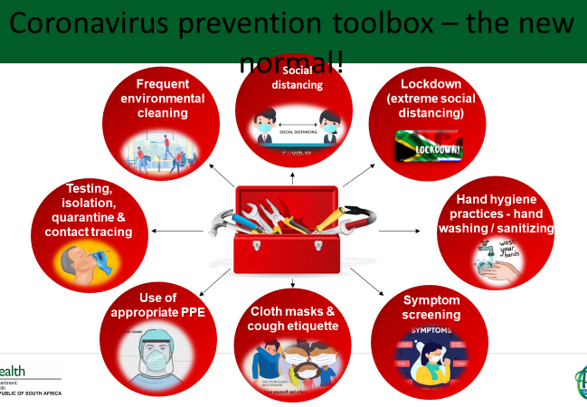
Districts designated for vigilance
Districts that currently have less than 5 active cases per 100 000 population should be under vigilance
Key interventions that should be practiced by these districts include all the items in the prevention toolbox plus close monitoring of cases

Slide 34
Vigilance and Emerging Hotspots (May 16 to May 22)
Definitions and Assumptions for Table :
Provides the Province Name
Provides color coded districts per the legend
Number of Actives per 100k population based on Average Active Cases based on data between May 16th to May 22nd
Calculates the delta or new positive cases Day 14 minus Day 7 (May 22 vs May 15)
Calculates the % change in new positive Cases between Day 14 to Day 7 (May 22 vs May 15)
Identifies vigilance, emerging hotspots, hotspots status.
If <5 active cases per 100k population defined as vigilance; or
if <5 active cases per 100k population and (≥)to the 80 percentile in % change (defined in E) then defined as Emerging Hotspot
If >5 cases per 100k population defined as hotspot

Slide 35
Hotspots

Slide 36
Districts designated as Hotspots
Districts with clusters with rapidly increasing cases
Need to intervene to contain the rapid rise
Sub-divide the district into sub-districts or wards
Deploy teams of health experts to analyse and support the district to implement enhanced activities to contain transmission (test, isolate/quarantine, treat)
Deploy multidisciplinary teams to support the implementation of any restrictions that may be necessary to contain the spread (including curbing movement of people)
Hard lockdown will only be considered if all other measures fail to contain the spread of the virus

Slide 37
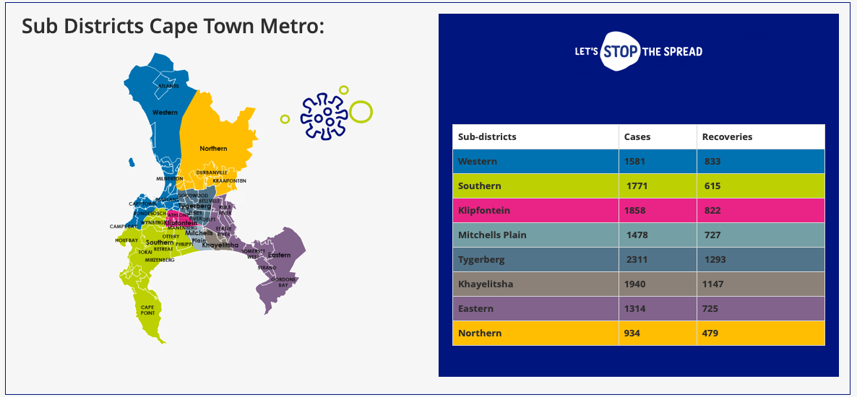
Example of Subdistrict Hotspots: Western Cape

Slide 38
Hotspots (May 16 to May 22)
Definitions and Assumptions for Table :
Provides the Province Name
Provides color coded districts per the legend
Number of Actives per 100k population based on Average Active Cases based on data between May 16th to May 22nd
Calculates the delta or new positive cases Day 14 minus Day 7 (May 22 vs May 15)
Calculates the % change in new positive Cases between Day 14 to Day 7 (May 22 vs May 15)
Identifies vigilance, emerging hotspots, hotspots status.
If <5 active cases per 100k population defined as vigilance; or
if <5 active cases per 100k population and (≥)to the 80 percentile in % change (defined in E) then defined as Emerging Hotspot
If >5 cases per 100k population defined as hotspot

Slide 39
Vigilance, Emerging Hotspots and Hotspots
(May 16 to May 22)

Slide 40
Further considerations for hotspots
To contain the spread of COVID-19 in hotspots; local leaders & communities may consider the following additional social distancing measures where possible:
  Restrict movement between areas of low and high transmission, including limiting use of public transport for emergencies and essential workers
  No gatherings in public places allowed
  No social or leisure events allowed
  Acceptance of isolation and quarantine if tested positive or a person under investigation in designated facilities (if this cannot be done safely at home)

Slide 41
Re-opening of essential services
Routine health services should be fully opened and run full services with attention to catchup childhood immunisation, contraceptive services, antenatal care, diagnosis and treatment of tuberculosis and HIV, management of chronic diseases, etc
Workplaces to re-open with protocols tailored to prevent outbreaks in sector specific work environments (such as factories, businesses, retail outlets and farms)
Re-opening of schools and universities in a systematic manner promoting risk mitigation with social distancing, hand sanitizing etc
Public Transport to be opened with steps to avoid overcrowding and ensuring good ventilation.
Careful planning for safe resumption of high-risk activities and businesses such as air travel, large gatherings (religious and cultural events, music concerts, sports events), hair/beauty salons, gyms, pubs, clubs and shebeens with risk-mitigation protocols

Slide 42
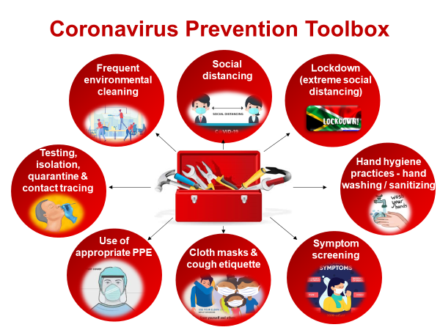
Mitigating risk as economic activity resumes
Protocol based combination of appropriate interventions from the coronavirus prevention toolbox, tailored to specific needs and settings
Continued prioritization of the protection of healthcare and frontline workers with adequate PPE
The level of activity (economic, social, etc) may need to be adapted within each a province where there there are multiple alert levels for effective coordination

Slide 43
Measures that would remain in place at all levels
Social distancing – the specific interventions to implement this principle would be contained in workplace/sector plans
Hand sanitizing available at all public spaces
Use of cloth masks outside of the home
The elderly and those with co-morbidities to remain at home
No public gatherings including sports events, concerts, nightclubs, bars, cinemas, etc

Slide 44
Communication to build public support and solidarity
A National Communication Campaign aimed at presenting data in an easy to understand manner with supporting evidence to explain the elements of the National COVID-19 response that are being implemented in response to the changing epidemic.
The National Communication Campaign’s primary aim to create solidarity and social movements in support of people adapting and adopting the New Normal that could be with us for a long time.
Communicate why restrictions on the movement of people is being eased while cases continue to rise and why panic and indiscriminate closures should be avoided as outbreaks continue to rise
Community buy-in and public monitoring of compliance by businesses and broader society with enforcement only when necessary

Slide 45
Summary
Swift, phased easing of the lockdown with the resumption of economic activity under conditions that provide simultaneous mitigation of risk
Implementation of intensive measures in hotspots to reduce the risk of repeated closures of institutions as outbreaks continue to increase. These districts remain at level 4.
All other districts move to level 3 alert level. Vigilance in low risk districts and fortnightly re-assessment of risk level with the potential move to level 2 and level 1 of certain districts.
Provincial command councils to submit plans on the effective management and coordination of districts based at various alert levels
Risk mitigation is based on the appropriate use of combinations of interventions from the coronavirus prevention toolbox

